Slide 1



Slide 2
Community Briefing

Slide 3
What is a Sustainable Energy Community?
A Sustainable Energy Community (SEC) is a group of people in which everyone works together to develop a sustainable energy system for the benefit of the community. This is achieved by:
Aiming, as far as possible, to be energy efficient
Using renewable energy where feasible
Adopting smart energy solutions
Use less
Use clean
Innovate

Slide 4
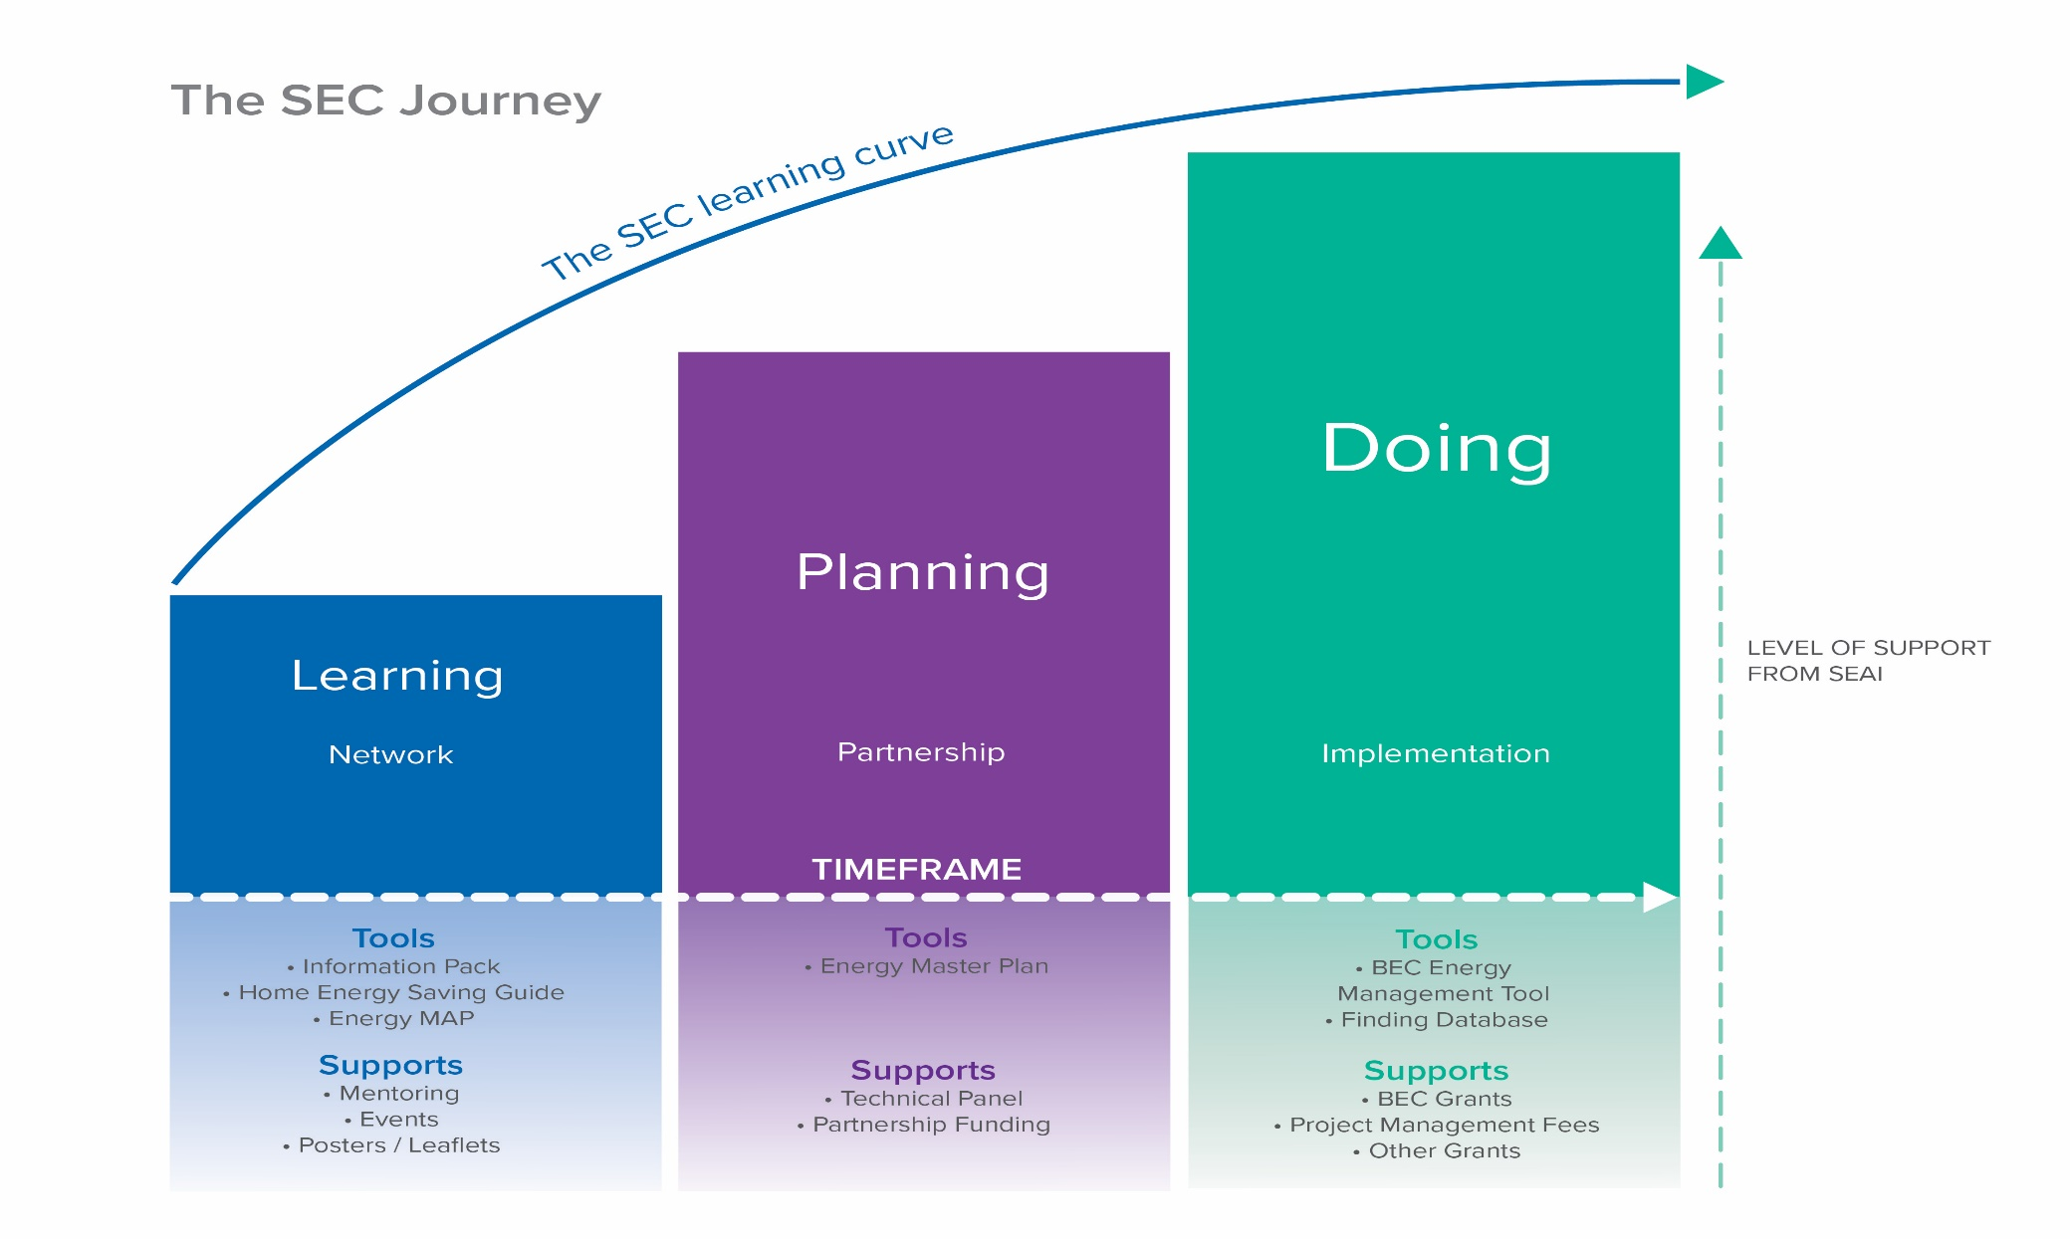
Learn – Plan - Do

Slide 5
Learn
The SEC Network

Slide 6
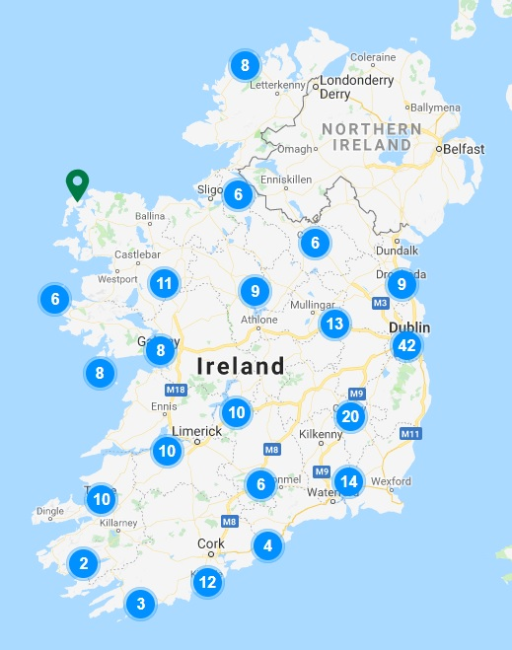
The Sustainable Energy Communities Network
SEC Network Map
https://www.seai.ie/community-energy/sustainable-energy-communities/sec-map/
Look for SECs with similar aims and objectives
Networking is encouraged
Ask your Mentor for an introduction

Slide 7
The Sustainable Energy Communities Network
Co. Galway:
SEC Name | Gaeltacht | L-P-D
Amicitia | No | Plan
Aran Co Op | Yes | Do
Ballinasloe Town Team SEC | No | Plan
Ballinderreen SEC | No | Plan
Ballyglunin Community Development Ltd | No | Learn
Clár Éifeachtacht Fuinnimh | Yes | Plan
Cloonascragh SEC | No | Learn
Comhar Caomhan Teo | Yes | Do
Comharchumann Shailearna Teo | Yes | Plan
Comhlacht Forbatha an Spidéal Teo | Yes | Learn
Corrib Catchment SEC | No | Learn
Cortoon Lavally Community Childcare | No | Learn
Dunmore Sustainable Community | No | Plan
Forbairt Chonamara Láir Teo | Yes | Plan
Galway PPN Green Recovery Linkage Group | No | Learn
Glenamaddy Sustainable Energy Community | No | Learn
Glinsk Community Development Society | No | Plan
Inishbofin Island | No | Learn
Kinvara Tidy Towns/Kinvara Community Council | No | Plan
Laurencetown Community Development Company | No | Learn
SCAN | No | Plan
Sustainable Energy West | No | Plan
Sustainable Headford | No | Plan

Slide 8
A diverse network of skills and interests
To date, there are 400+ communities in the network. Who are they?
Small rural towns
Large urban centres
Neighbourhoods
Third level institutions
Residents' Associations
Tidy Towns Committees
Suburban community organisations
Local environmental groups
County councils
Business groups
Housing Associations

Slide 9
What are the benefits of joining the network?
Mentoring
Learning supports
Get in touch with other communities who have common interests
Learn from communities who have conducted local energy projects
Start thinking about energy use in your own community in an informed way
Learn from energy experts
Attend regional and national events

Slide 10
Plan
The SEAI Partnership & Energy Master Plan

Slide 11
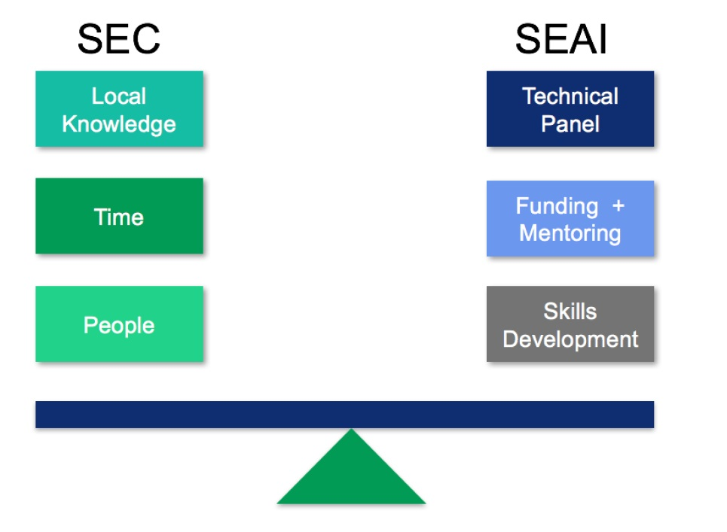
The Partnership Approach
The SEC partnership approach aims to enable bottom-up community energy solutions. Such a task cannot be achieved in isolation, so we want to partner with willing communities in planning for their energy future. SECs who are already in the SEC Network are encouraged to enter into a partnership with us.

Slide 12
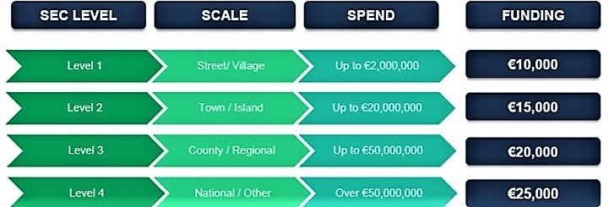
The Partnership Approach – the next steps
Community Charter – a vision for your community, what are your goals and priorities?
Competency Assessment – what are your strengths and weaknesses, and where can we help you fill the gaps?
Energy Master Plan Funding application

Slide 13
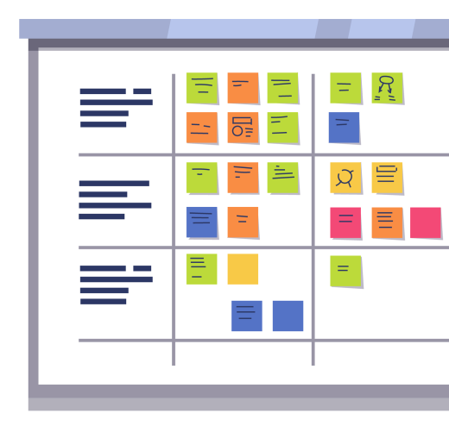
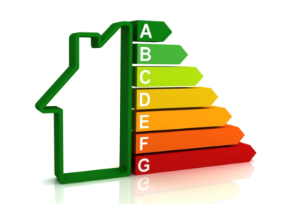



The Energy Master Plan
Baseline of current energy use
Assessment or RE resources
Register of Opportunities
Database of buildings/facilities/fleets/RE
Quantify associated energy: €, kWh, BER, CO₂
Project list
Categories / targets / ranking

Slide 14
Do
Projects & Community Grants

Slide 15

SEAI Grant schemes
Which one is right for me?
Lots of confusion and bad publicity
Different timeframes & structures
Changes from one year to the next

Slide 16
SEAI Grant schemes
Homeowners – 2 main options
Warmer Homes Scheme | Better Energy Homes
Free Upgrades for eligible homeowners | Fixed grants for a menu of measures
Others – can include homeowners
Community Energy Grant – also know as Better Energy Communities (BEC)
% of costs for wide range of measures Community wide project with multiple beneficiaries

Slide 17
SEAI Grant schemes
Warmer Homes Scheme
Who is it for:
‘Energy Poor’ Homeowners – homes built before 2006 - in receipt of one of the following:
Fuel Allowance as part of the National Fuel Scheme.
Job Seekers Allowance for over six months and have a child under seven years of age
Working Family Payment
One-Parent Family Payment
Domiciliary Care Allowance
Carers Allowance and live with the person you are caring for
Delivered Free of Charge
Must own and live in the home treated, which must have been built and occupied before 2006
    What is offered:
    Attic insulation
    Wall insulation
    Lagging jackets & Energy advice
    Draught proofing
    Low energy light bulbs
    Windows*
    Heating upgrade*
    *Subject to survey
    How to apply:
    Website https://www.seai.ie/grants/home-energy-grants/free-upgrades-for-eligible-homes/
    or Freephone 1800 250 204

Slide 18
SEAI Grant schemes
Better Energy Homes
Measures | Energy Efficient Measures | Grant
Insulation | Attic insulation | €400
 | Cavity wall insulation | €400
 | Internal Insulation (Dry Lining)
 | Apartment (any) OR Mid-terrace House | €1,600
 | Semi-detached OR End of Terrace | €2,200
 | Detached House | €2,400
 | External Wall Insulation ('The Wrap')
 | Apartment (any) OR Mid-terrace House | €2,750
 | Semi-detached OR End of Terrace | €4,500
 | Detached House | €6,000
Heating System | Heating Controls Upgrade | €700
Heat Pump | Air/Ground to Water system | €3,500
 | Air to Air system | €600
Solar Thermal | Solar Thermal | €1,200
BER |  | €50
Solar Electricity | Solar PV (with option for battery) | €700/kWp €1,000 for battery
Who is it for:
Homeowners and landlords – homes built before 2006
Do more, receive more:
3 upgrades = bonus €300
4 upgrades = bonus €400
    How to apply:
    Apply online https://www.seai.ie/grants/home-grants/better-energy-homes/

Slide 19
SEAI Grant schemes
Community Energy Grant – formerly Better Energy Communities (BEC)
Who is it for:
All community sectors – homeowners, landlords, public sector, business, community organisations
Grant rates (% of eligible costs):
Homeowners - Non-energy poor: Up to 35%
Homeowners - Energy poor: Up to 80%
Local Authority homes: Up to 35%
Housing Associations: Up to 50%
Public/Private sector: Up to 30%
Community/Charity sector: Up to 50%
    Measures that are grant supported:
    Wide range of upgrades including: insulation; heating controls; heat pumps; wood fuel stoves; doors & windows; biomass boilers; solar thermal (hot water); Solar PV; lighting

Slide 20
SEAI Grant schemes
Community Energy Grant – formerly Better Energy Communities (BEC)
    How to join a Community Energy Grant application:
    Individual homeowners or building owners can’t apply directly
    You need to find a Project Coordinator that is organising an application
    Advantages of the Community Energy Grant:
    % of costs versus fixed grant per measure – generally better value
    Economies of scale for larger projects
    Project Coordinator looks after procurement, deals with the contractor and with SEAI

Slide 21
Co. Galway
A quick look at energy use in your community

Slide 22
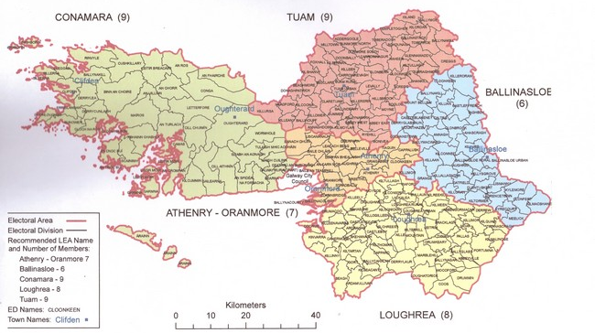
Co. Galway

Slide 23
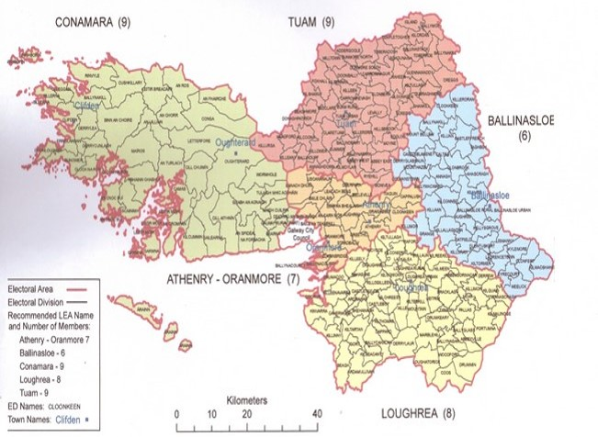
Estimate of residential sector energy
Census 2016 | Value
Population | 179,390
Homes (total) | 78,207
Homes (non vacant) | 68,561
Cars | 94,111
Estimate of annual energy spend | Value
Average spend for home energy | €1,900
Average spend for transport fuel | €1,500
Annual spend for homes (non vacant) | €130,265,900
Annual spend for cars | €141,166,500
Total annual energy spend | €271,432,400
SEC Level | Level 4
EMP funding | €25,000

Slide 24
Population:
Typical rural profile – loss of 3rd level students and young workers

Slide 25
Housing age:

Slide 26
Homeowners:
77% owner occupied

Slide 27
Home heating:
This decade will see more heat pump installations

Slide 28
Commuting to work

Slide 29




Changing for the better
Transitions for knowledge - Getting ‘Smart’ about energy
Understand your costs and what you’re paying for
Record your energy use to check for improvements
Transitions for homes
How to run an energy efficient home – what to look out for and change
Appropriate efficiency upgrades – 1st measures, 2nd and 3rd measures
Available supports – financial and technical
Transitions for transport
Public transport options
Increase cycling and walking
Working from home / remote working
Electric/hybrid vehicle options
Transitions for community
Work with your Sustainable Energy Community team
Establish a Roadmap to start your community transition

Slide 30
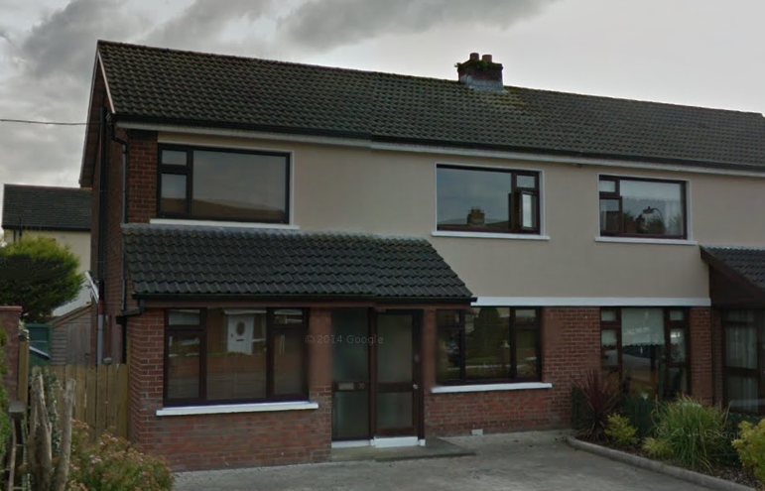
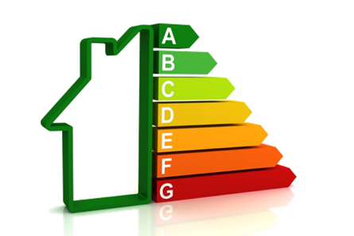
Changing for the better
Investment in upgrades
Built 1973. Previous owner energy bills c.€2,500 (c. F/E2 BER)
Moved in 2005
Cavity wall insulation – Better Energy Homes
Boiler upgrade – Better Energy Homes
DIY/Renovation:
  Stove in the open fire
  Repairs/Servicing heating and hot water
  New insulated hot water tank
  Pipe lagging / draught proofing
  Underfloor insulation
  Double glazing of remaining single glazing
  Front & rear doors
  Attic insulation
Electricity and oil monitors in place
Current energy bills < €1,300 (c. C2 BER)
Electric Car – 2016 Nissan LEAF (30 kWh)
Ongoing / planned
LED lighting
Heating controls
Heat pump and deeper retrofit

Slide 31

Questions
Mel Gavin – IT Sligo
Gavin.mel@itsligo.ie
086 3099184

